Slide 1

RANDOM PASSWORD GENERATOR
Code Documentation | DecodeLabs Python Programming Industrial Training Kit
Project 3
Author: Laiba Maqbool
Batch: 2026

Slide 2


Project Overview
Goal
Quick Facts
Min Password Length
Ask the user for a desired password length and generate a random, secure password using Python's built-in random and string modules.
6 characters
Max Password Length
50 characters
How It Works
Character Sets
Upper, Lower, Digits, Symbols
The program collects the desired length and character preferences, builds a character pool, then randomly selects characters to build the password.
Core Modules
random, string
Structure
7 functions + main()

Slide 3







Concepts Used
Seven core Python concepts demonstrated in this project
Importing Modules
Functions
String Manipulation
Loops
random & string
Modular reusable blocks
Building char pools
for & while iteration
Conditional Statements
Input Validation
Random Generation
if / elif / else logic
Safe, robust user input
random.choice() sampling

Slide 4
Program Architecture
Function call flow inside main()
print_header()
get_password_length()
ask_user_preferences()
build_character_pool()
generate_password()
check_strength()
display_password()
Loops while user chooses to generate another password -> each result appended to history[]
show_history() -> Program ends

Slide 5


Configuration & Character Sets
Length Limits
LOWERCASE
UPPERCASE
6
string.ascii_lowercase
string.ascii_uppercase
a-z
A-Z
MIN_PASSWORD_LENGTH
50
DIGITS
SYMBOLS
MAX_PASSWORD_LENGTH
string.digits
string.punctuation
0-9
!@#$%^&*

Slide 6
Functions - Input & Setup
get_password_length()
Repeatedly prompts the user until a valid integer within MIN_PASSWORD_LENGTH and MAX_PASSWORD_LENGTH is entered. Uses str.isdigit() to reject non-numeric input.
ask_user_preferences()
Asks four yes/no questions (uppercase, lowercase, digits, symbols) and returns a tuple of booleans representing the user's chosen character types.
build_character_pool()
Concatenates the selected character sets (UPPERCASE, LOWERCASE, DIGITS, SYMBOLS) into a single pool string used for random selection.

Slide 7
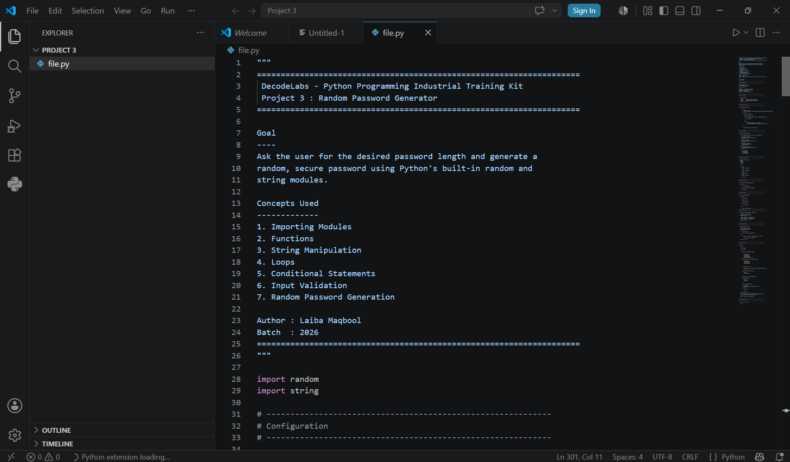

Slide 8
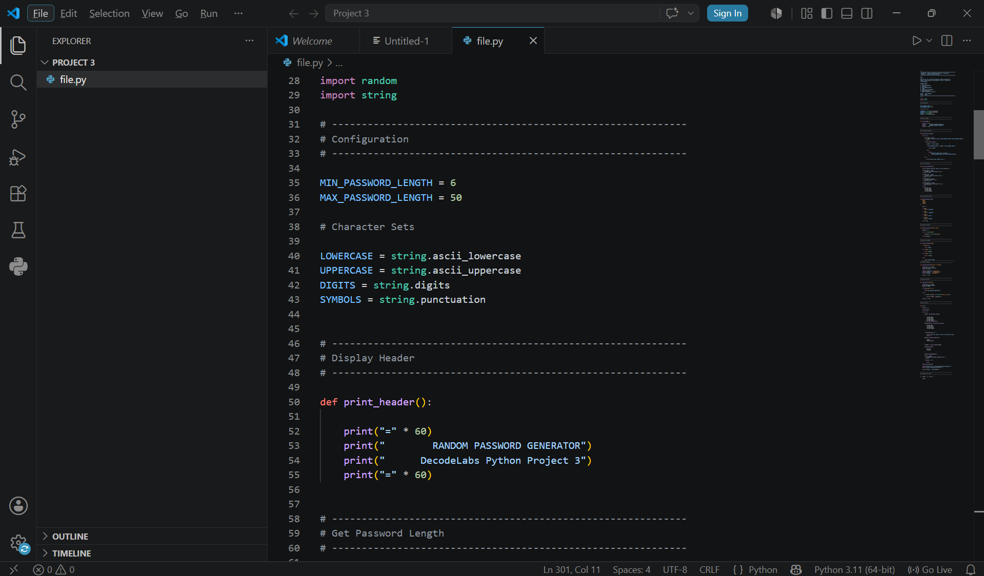

Slide 9
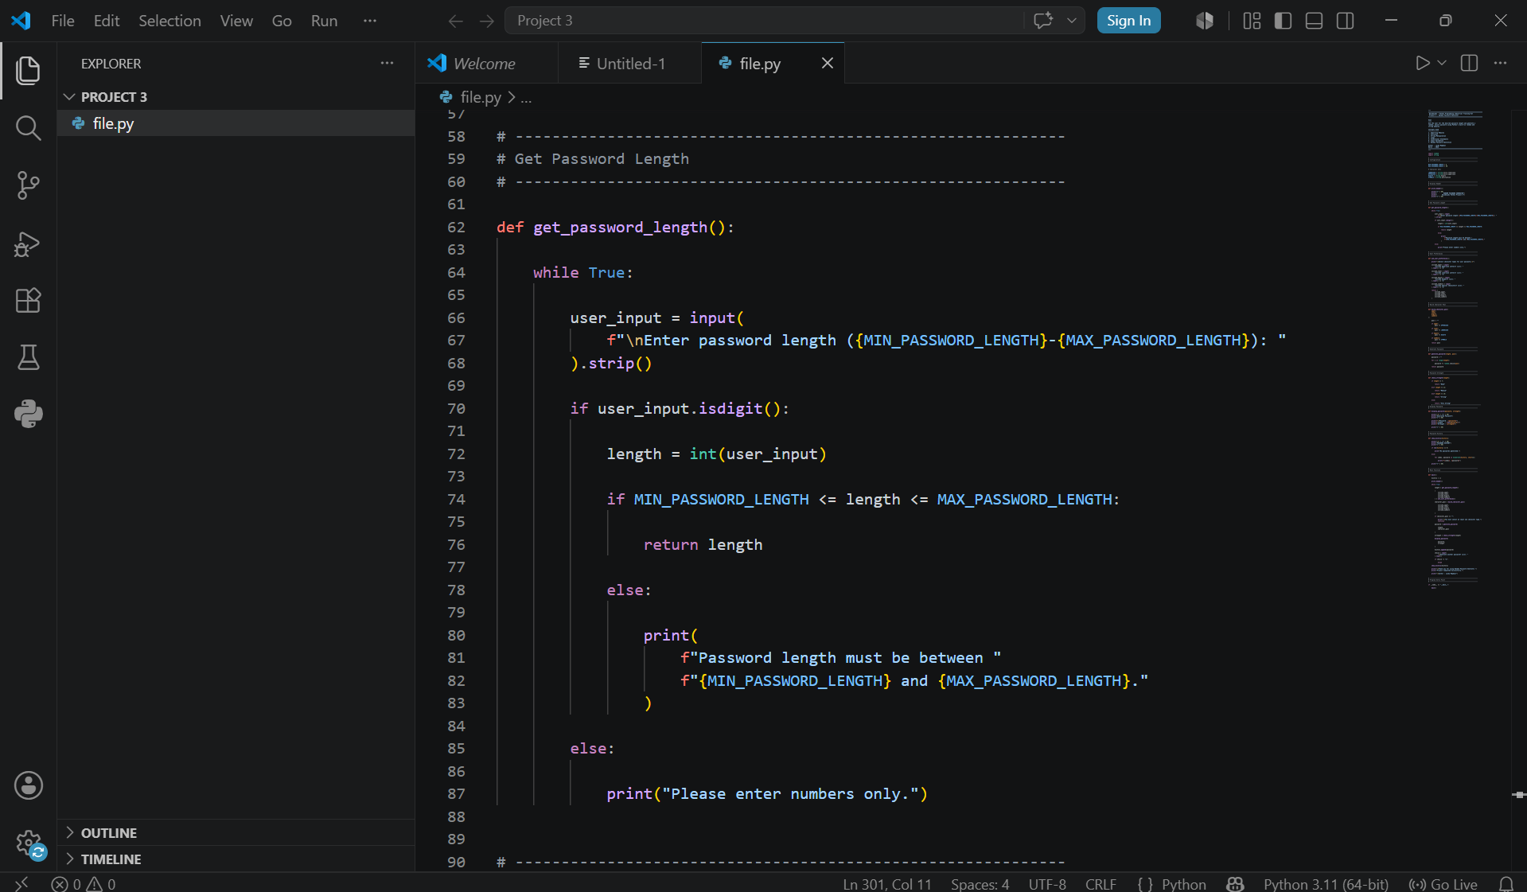

Slide 10
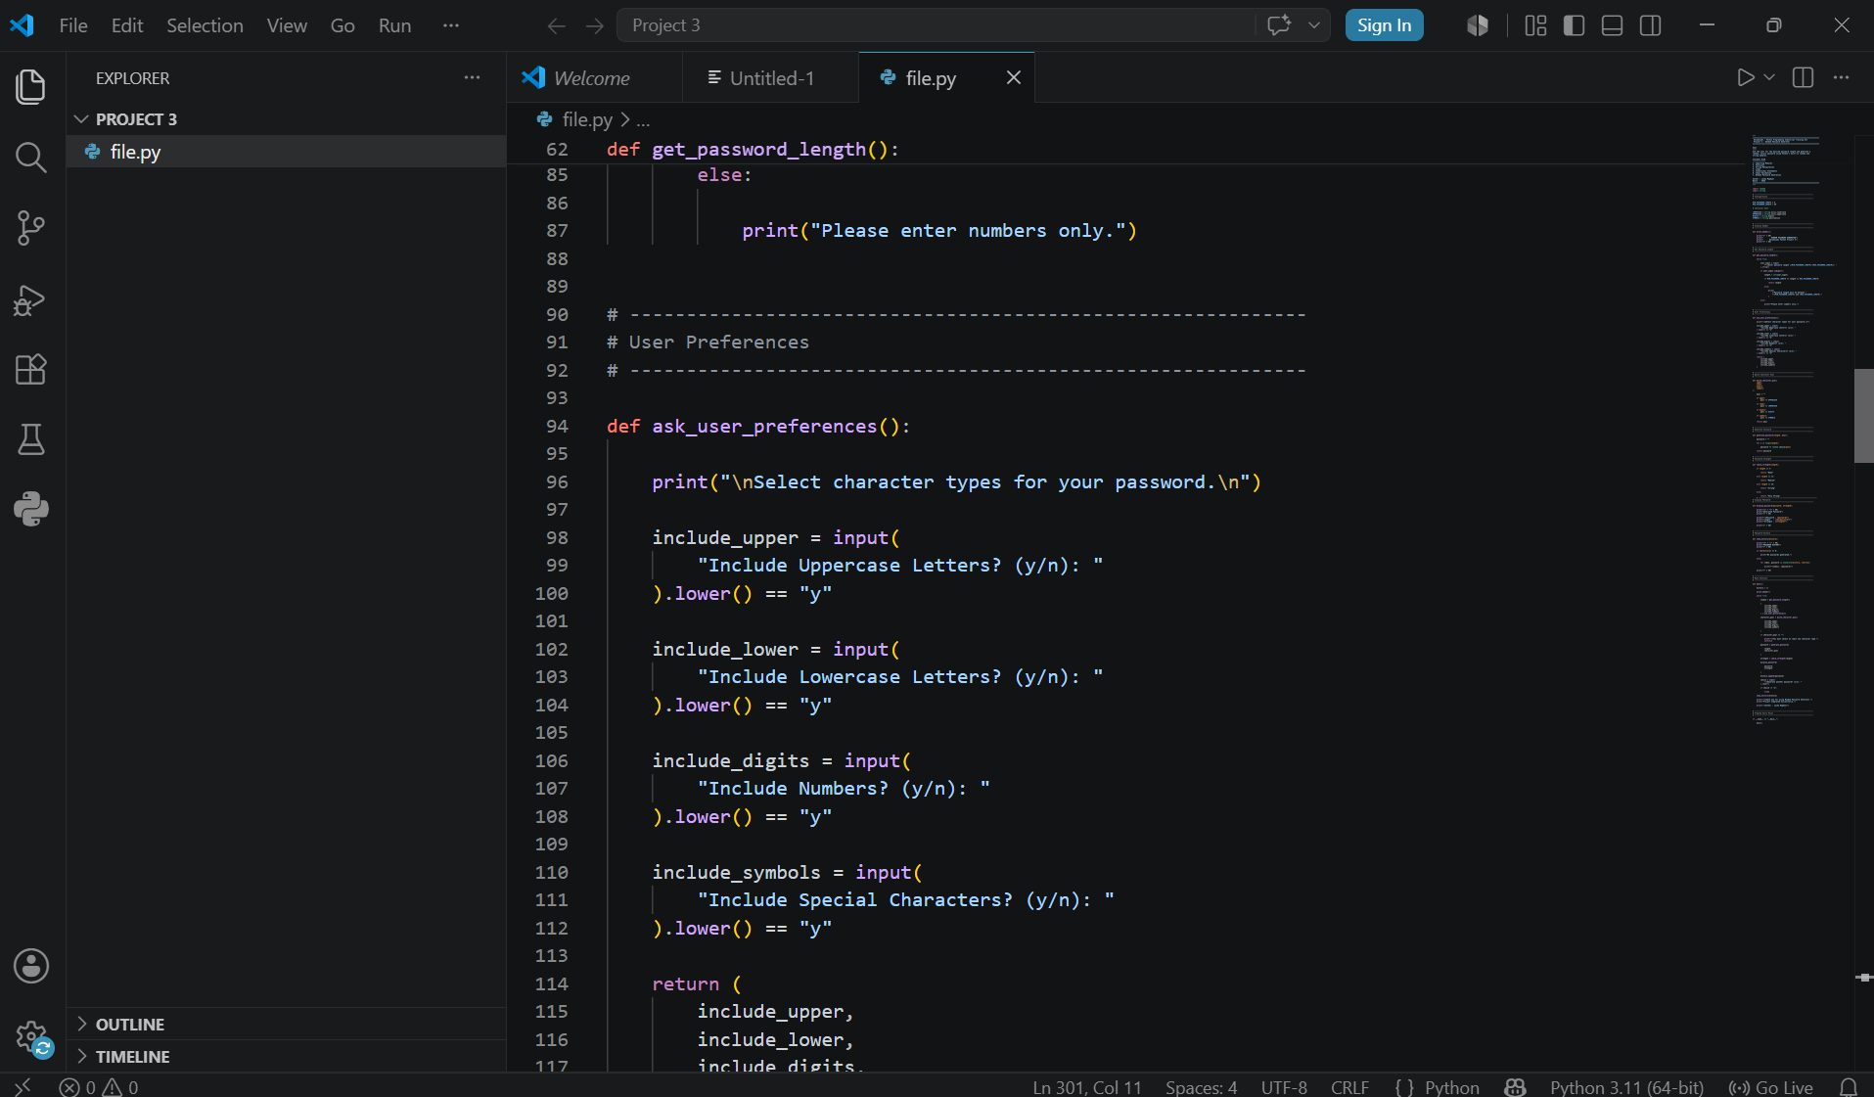

Slide 11
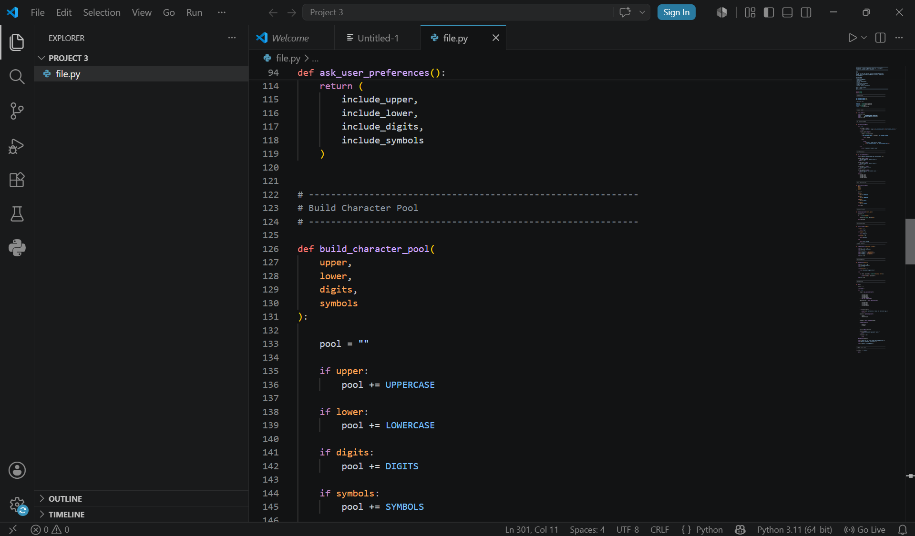

Slide 12
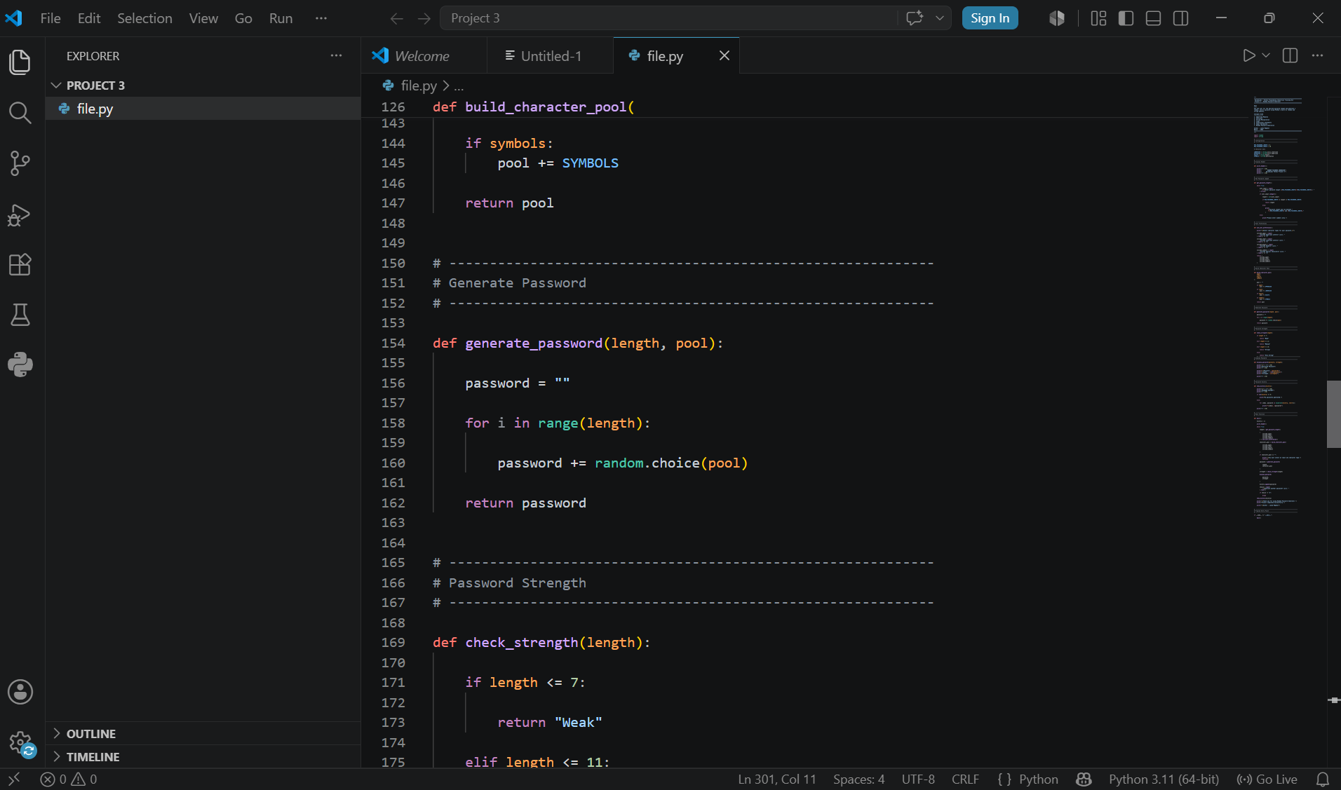

Slide 13
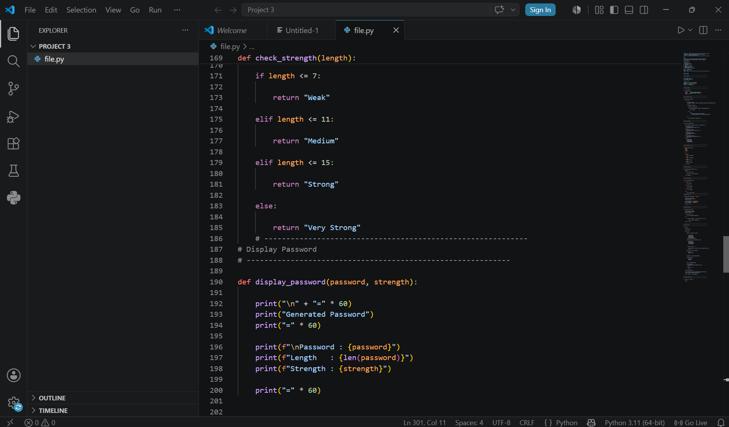

Slide 14
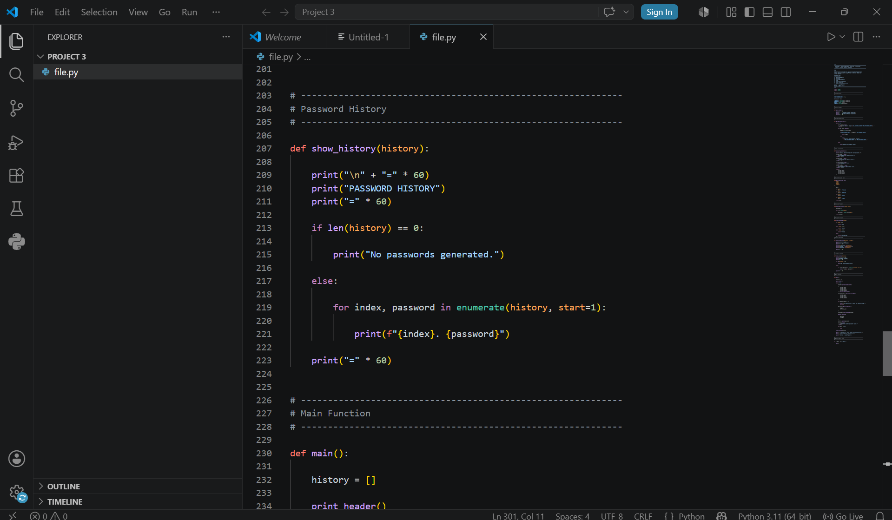

Slide 15
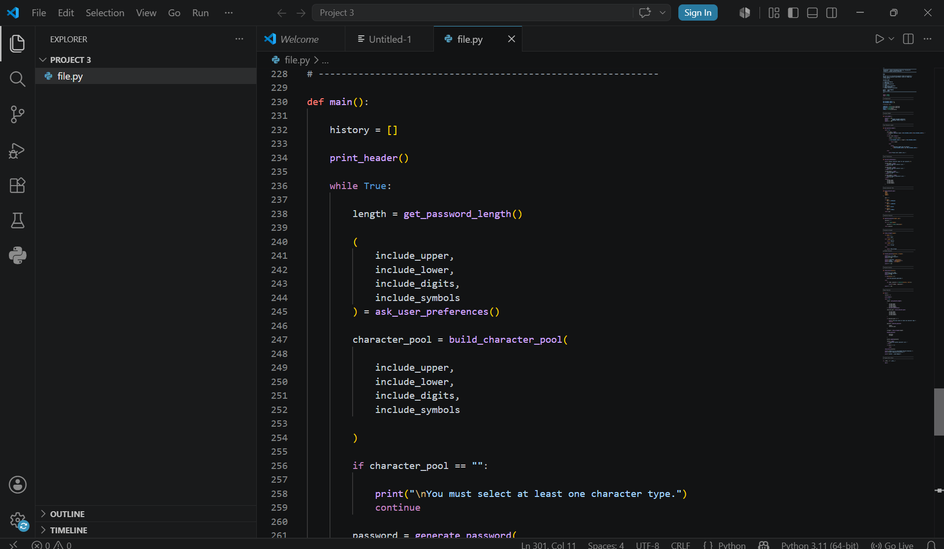

Slide 16
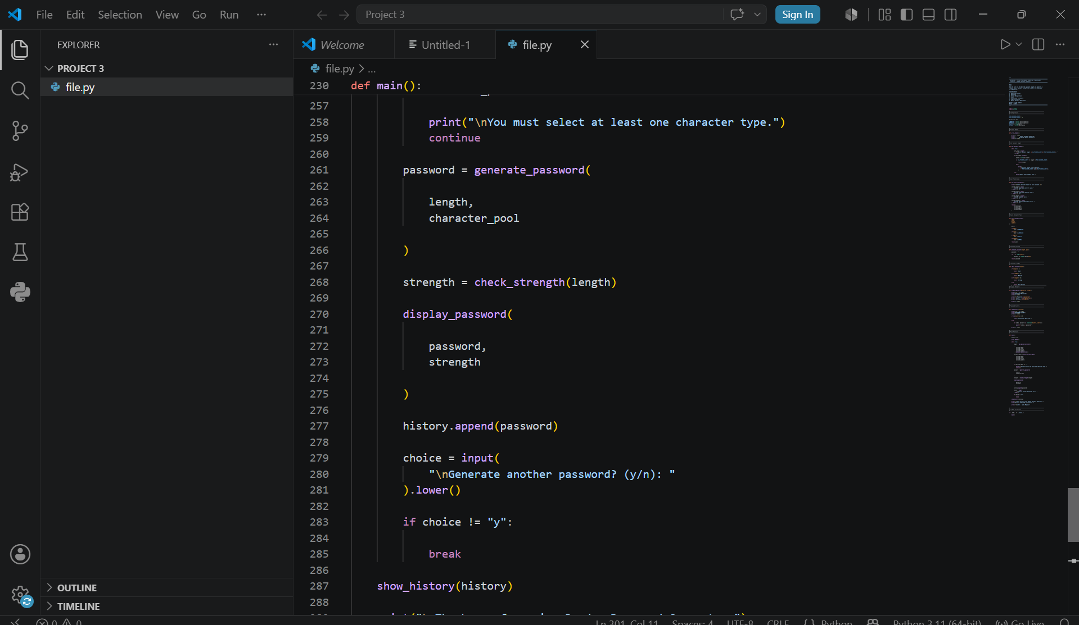

Slide 17
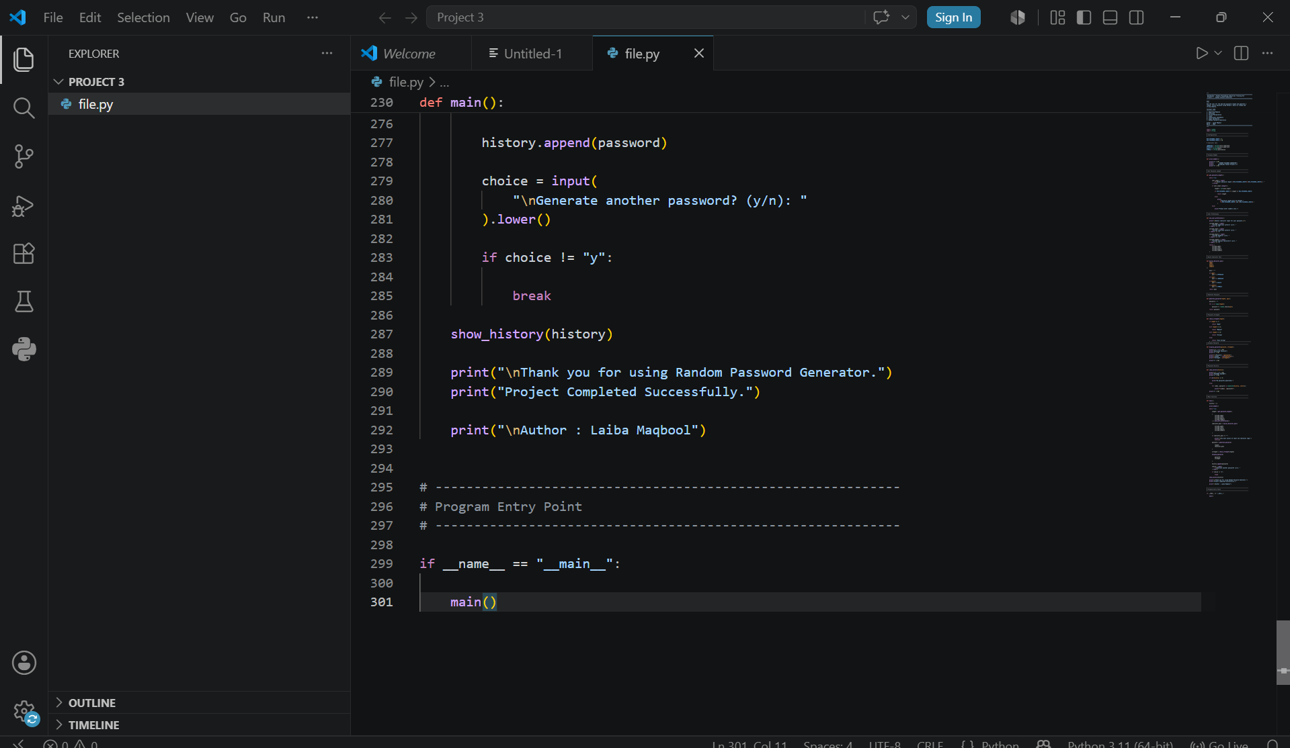

Slide 18


Functions - Generation & Output
generate_password(length, pool)
Loops `length` times, appending a random.choice() character from the pool each time to build the final password string.
check_strength(length)
Classifies password strength purely by length: <=7 Weak, <=11 Medium, <=15 Strong, else Very Strong.
display_password() / show_history()
display_password() prints the password, its length, and strength. show_history() lists every password generated during the session.

Slide 19

Password Strength Criteria
check_strength(length) classifies passwords by length only
<= 7
8 - 11
12 - 15
16+
characters
characters
characters
characters
Weak
Medium
Strong
Very Strong
Note: strength here reflects length only - it does not check character variety.

Slide 20
Main Program Flow
1
Print header & start empty history list
5
Generate password & determine strength
2
Ask for password length (validated)
6
Display password and add to history
3
Ask for character type preferences
7
Ask to generate another - loop or exit
4
Build character pool (must not be empty)
8
Show full password history & finish

Slide 21
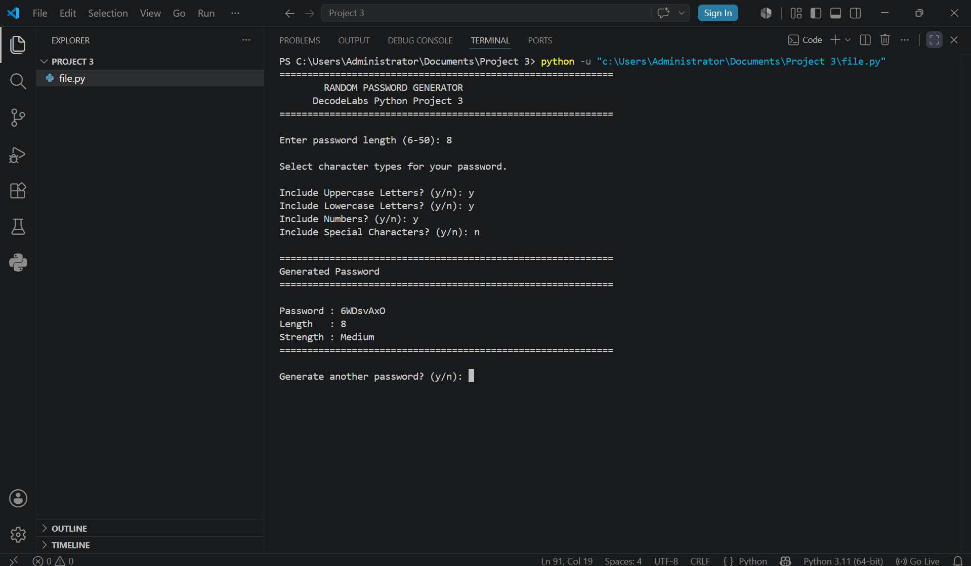
Sample Run
random.choice()
Selects one character at a time from the pool for each loop iteration.
Input Validation
Rejects non-numeric input and enforces the 6-50 length range.
Session History
Every generated password is stored and listed at the end of the run.

Slide 22
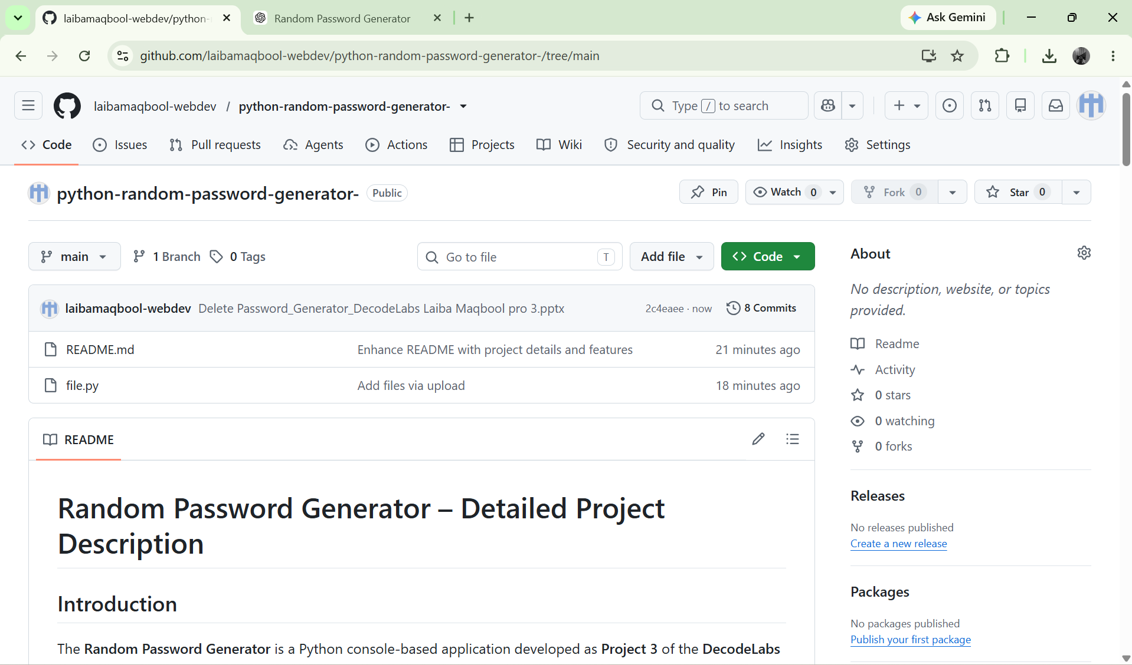

Slide 23
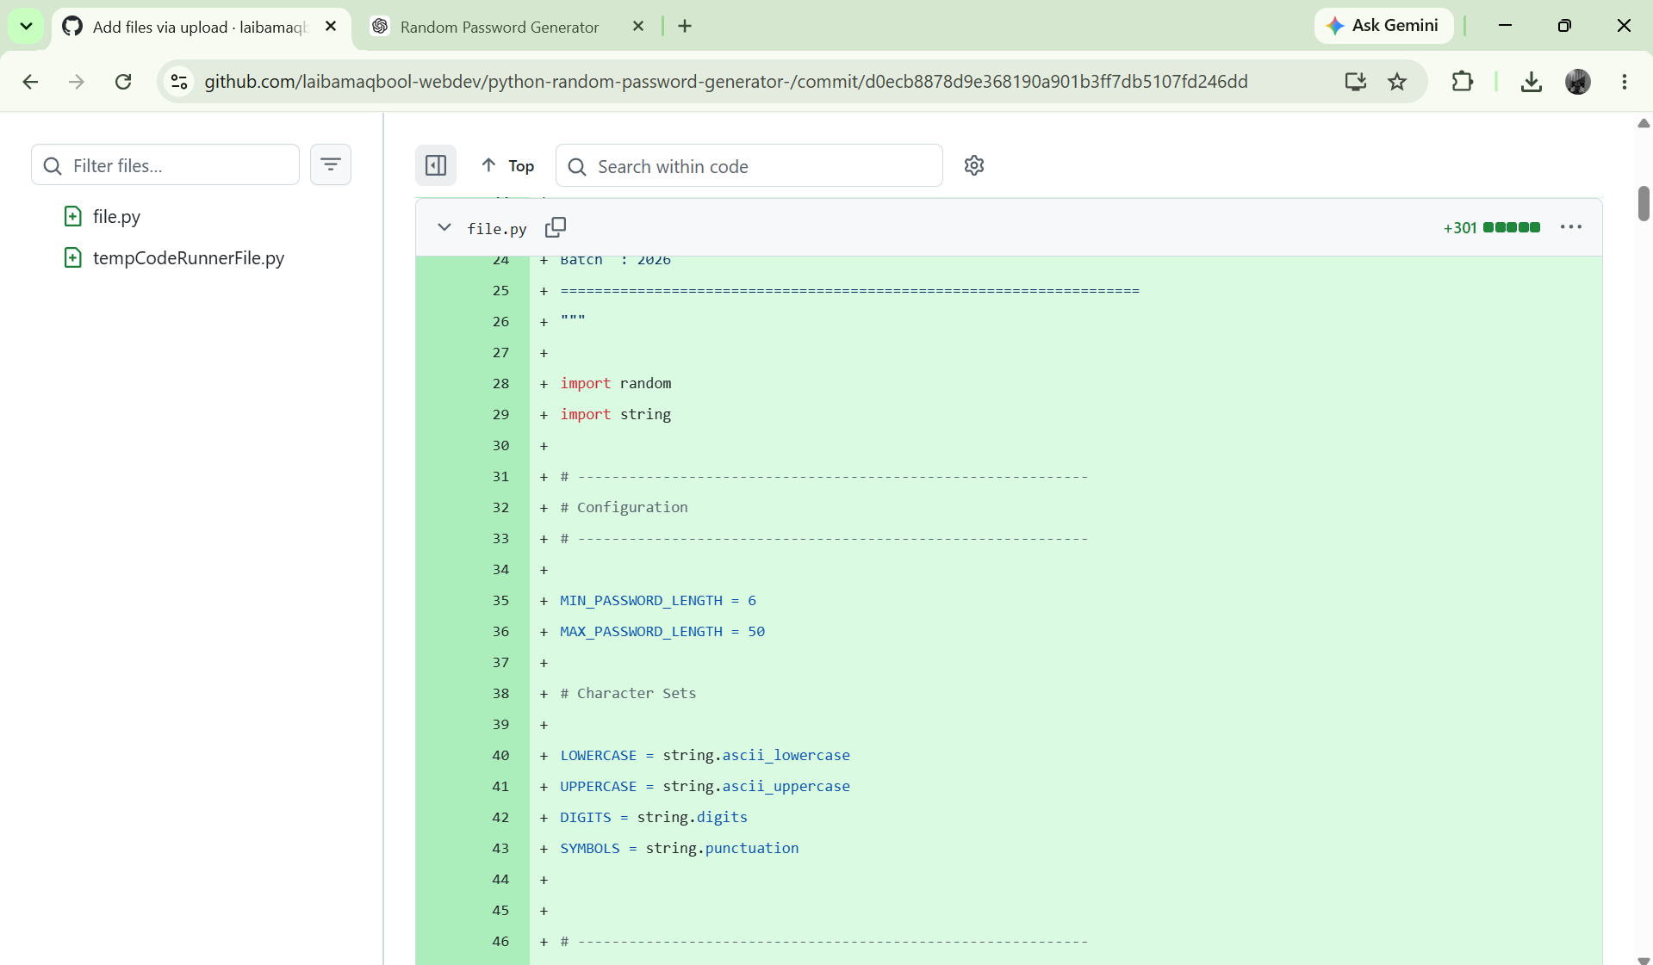

Slide 24
Project Completed Successfully
Thank you for reviewing the Random Password Generator documentation.
Author: Laiba Maqbool
Batch: 2026
DecodeLabs Python Programming Industrial Training Kit

